Slide 1


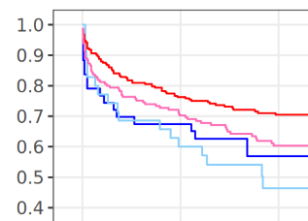

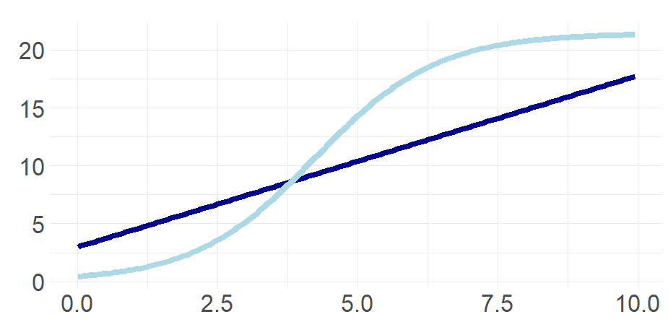
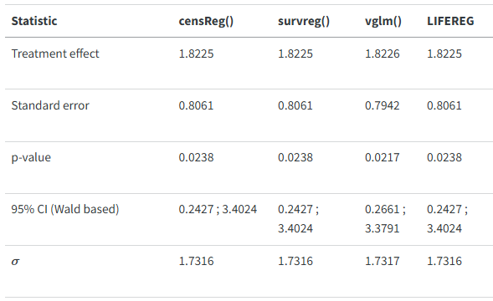
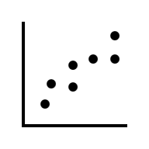

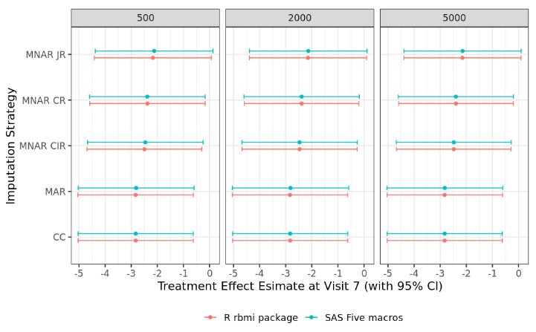
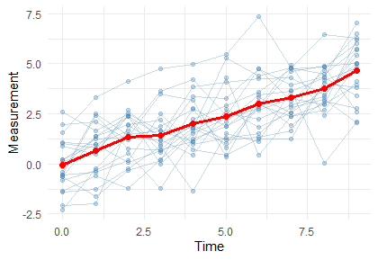



SAS to R Infographic
Documenting Important Differences Between SAS & R
Martin Brown (Thermofisher, UK), Lyn Taylor (Parexel, UK), Christina E Fillmore (GSK, UK) & Yannick Vandendijck (Johnson & Johnson, Belgium)
On behalf of the PHUSE DVOST CAMIS working group and PSI AIMS SIG
CAMIS: Comparing Analysis Method Implementations in Software:
https://psiaims.github.io/CAMIS/
Background:
It is challenging to replicate analysis results across different software
CAMIS Aims:
Explain why analyses method results differ
Provide solutions to make them align (where possible, including R package selection)
Make efficient use of community resources to research differences
Method: Document findings in open source repository
Demonstrative Results: See below
Conclusions: Generally, SAS & R align. Discrepancies likely due to differences in default methodological choices or algorithmic variation
Call to action: Please use and contribute to the CAMIS repo
New Pages Coming soon: CIs for proportions & CIs for rates
Analysis Method | SAS | R | Similar!?
Rounding | round(2.5) > 3 Rounding ‘away from zero’ | round(2.5) > 2 Rounding ‘to the even number’ | Not by default! SAS: use rounde function to round to event R: use janitor::round_half_up() to round away from zero
Cox proportional hazard regression | proc phreg Default uses Breslow method for handling ties | survival::coxph() Default uses Efron method for handling ties | Not by default! SAS: include “TIES=EFRON” in MODEL statement R: include “ties=‘breslow’” in coxph() function {survival} prior to v3.8.0 can’t fit a stratification variable using “+survival::strata(<var>)” use “+strata(<var>)”
Logistic regression | proc logistic Default uses effect coding for categorical variables | stats::glm() Default uses glm coding for categorical variables | Not by default! SAS: include “PARAM=GLM” or “PARAM=REFERENCE” in CLASS statement R: No option to use effect parameterization
Tobit regression | proc lifereg Important to use MODEL (lower, Y), when lower is missing, then Y is used as a left-censored value | censReg:: censReg() survival:: survreg() VGAM::vglm() Several R packages could be used | censReg() & survreg() match SAS vglm() slight differences
Reference-based multiple imputation and tipping point | LSHTM five macros Rogers 2022 The macros fit a Bayesian Normal Repeated Measures model and then impute post-withdrawal data under a series of possible post-withdrawal profiles | rbmi package Implements standard and reference based multiple imputation methods for continuous longitudinal endpoints Implements tipping point using delta argument of the analyse() function | Yes. Within acceptable tolerance! Each panel represents a different number of imputation draws MAR = missing at random; MNAR = missing not at random; CIR = copy increment from reference; J2R : jump to reference; CR = copy reference; CC = complete case
Generalized Estimating Equations (GEE) Models | proc gee or proc genmod Use lsmeans statement with ilink option for probability of event or with exp or oddsratio for odds ratios | geepack::geeglm() with emmeans::emmeans() for probability of event and odds ratios gee:gee (but emmeans not supported) | For Binary Outcome Yes ! SAS & R defaults are the same ‘independence’ correlation matrix and sandwich SE Different options are available for other correlation matrices and model-based (naïve) SE SAS also has clogit & glogit link functions available See CAMIS repo for outcomes with >2 categories.
0 1 2 3 4 5 6 7 8 9
Regression + modelling censored variables
Original
Incomplete Data
Imputed datasets
Analysis
Results
Pooled
Results

